Slide 1


Impact of Social Sciences, Humanities and Arts Conference
The Parallel Session on:
Collaboration to Understand Needs and Challenges
14 October, 2021

Slide 2


Impact of Social Sciences, Humanities and Arts
13-15 October, 2021
Fanny Sbaraglia (Chair): Researcher at the Center for the Study of Politics (CEVIPOL), Scientific Advisor to the Policy Lab, Université Libre de Bruxelles
Koen Verlaeckt: Secretary-General, Vlaamse Interuniversitaire Raad (VLIR), Belgium
Overview of the Speakers
#SSHA21

Slide 3
Impact of Social Sciences, Humanities and Arts
13-15 October, 2021
Koen Verlaeckt
Secretary-General, Vlaamse Interuniversitaire Raad (VLIR), Belgium
#SSHA21

Slide 4
Saving lives, saving money, saving time
An urgent call for better policy data
Koen Verlaeckt
Secretary General
Flemish Interuniversity Council

Slide 5
Context
High-quality policy data are a prerequisite for better policy and better policy-oriented research
Lack of data leads to disproportionate policy decisions, costing lives, money and time
Existing data are fragmented and notoriously difficult to mine; the existence of different layers of government adds to the complexity

Slide 6
Context
There is awareness and that is a good thing: data-driven policymaking is a top priority in all official policy papers
But the pace of change is too slow
The Socio-Economic Council of Flanders (SERV) and VLIR decided to join forces in formulating recommendations, inspired by their thematic experience with labour market and health policy data

Slide 7
Box - labour market
The Labour Market and Social Protection Datawarehouse (DWH AM&SB) is a key database for labour market policy research. However the availability of data comes with a serious delay (up to three years), reducing its potential to address current policy needs.
Regional differences between datasets in Flanders, Brussels and Wallonia impede researchers to apply for European or international research grants on country-wide comparative topics.

Slide 8
Box – health policy
During the covid-19 crisis, privacy rules were invoked as an argument not to share data on the number of contaminations on the work floor.
The fragmentation of health data between different layers of government and the refusal to share data between actors caused a serious backlog in monitoring the covid-19 crisis. This was the case for the mortality statistics in hospitals and residential care centres. It even led to extremely negative international publicity.

Slide 9
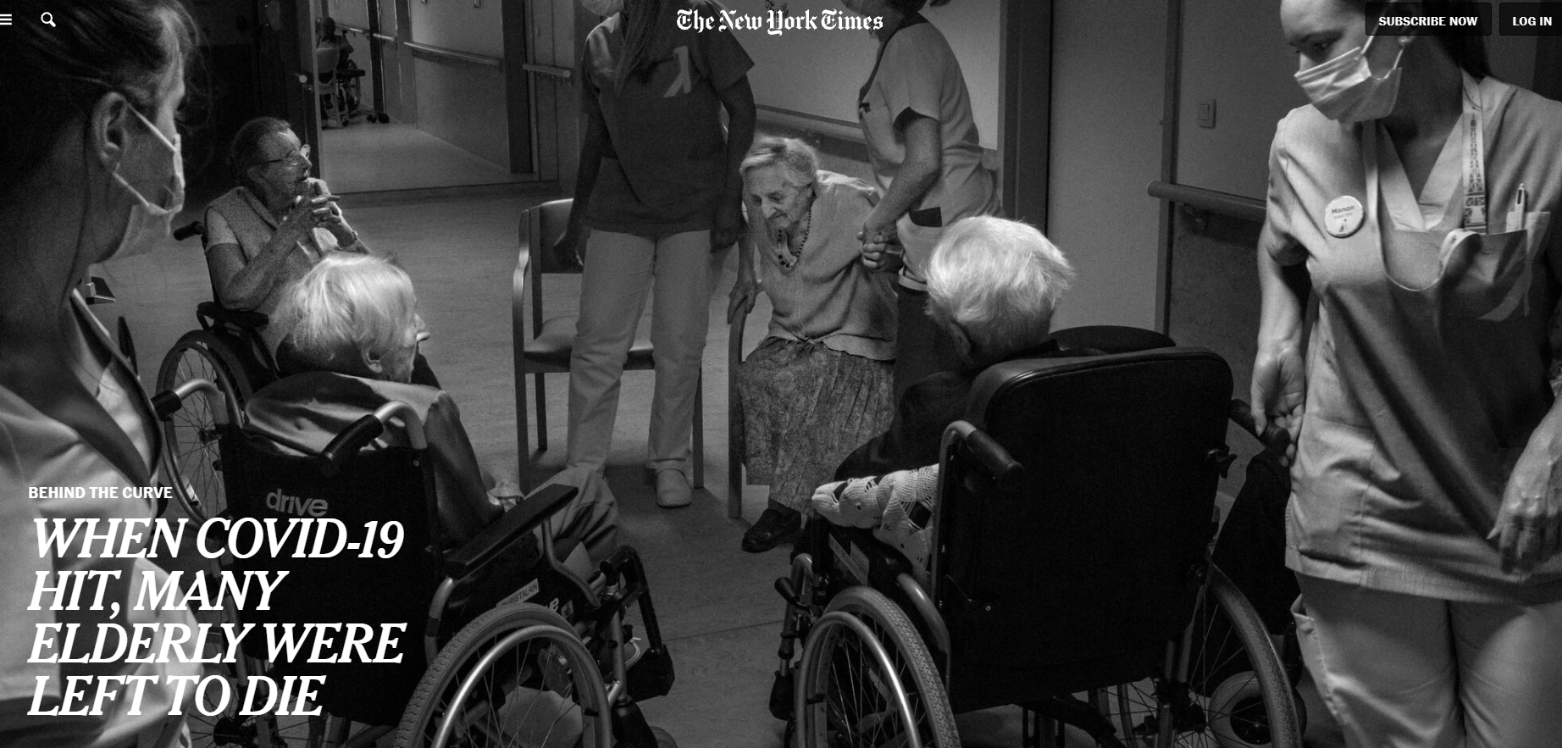

Slide 10
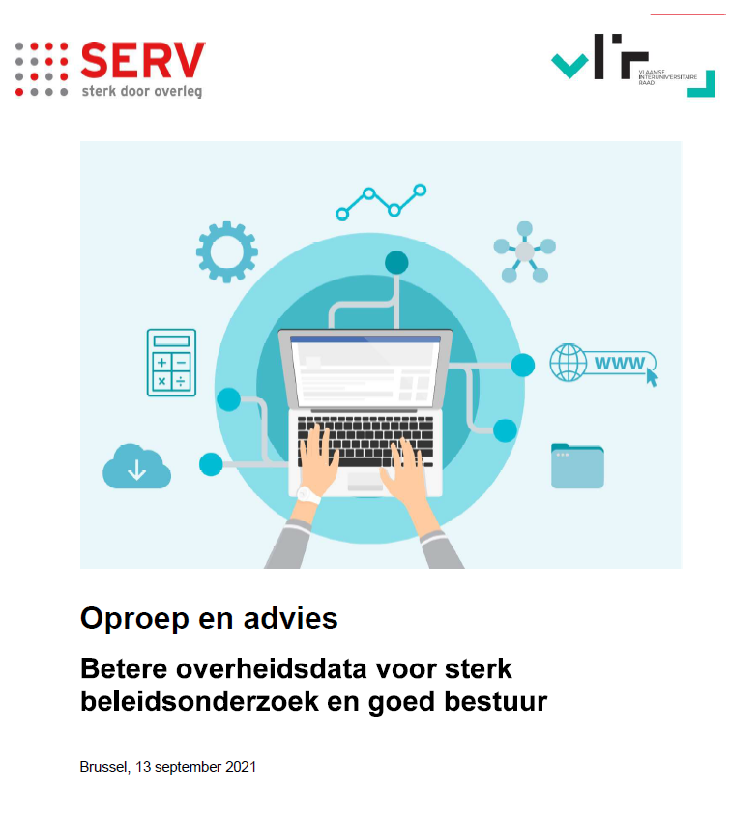

Slide 11
Recommendations
Availability of high-quality data
Findability and disclosure of data
User-friendliness and ethical handling of data
Mindset and governance

Slide 12

Availability of high-quality data
Put structural mechanisms in place to detect data needs, data gaps and data errors
Assign clear responsibilities to document and to maintain data
Apply existing and validated data standards
Develop a strategy that generates high-quality data
Avoid case-by-case applications and grant access by default to recognised centres of excellence

Slide 13

Findability and disclosure of data
Put a Flemish data warehouse in place. Focus on high value datasets
Don’t conceive the warehouse as a repository, but as a meta database which refers to high quality data sets. Stimulate other actors, such as universities, to act as data custodians
Go beyond the disclosure of raw data. Government should build its own data infrastructure

Slide 14

User-friendliness and ethical handling of data
Privacy to be protected, but the legal framework should not become an impediment
Simplify and shorten the procedures to obtain data for research purposes
Ensure ethical use of data (self-regulatory code of conduct for responsible data management; Berlin Declaration on e-inclusion

Slide 15

Mindset and governance
We need a shift from “data is power” to “data-sharing is even more power”
Gather data on the basis of the only-once-principle
Establish an adequate data governance structure in consultation with all stakeholders
Invest in data literacy

Slide 16
Next steps
Set up a structural dialogue between government, scientists and other stakeholders
Present the report to political and administrative stakeholders
Present the report on academic fora
Discuss the recommendations with other levels of government

Slide 17
Contact
Koen Verlaeckt: koen.verlaeckt@vlir.be
Peter Van Humbeeck: pvhumbeeck@serv.be

Slide 18
Impact of Social Sciences, Humanities and Arts
13-15 October, 2021
Thank you!
#SSHA21

